Slide 1

Lecture 1
Development Framework

Slide 2

A G E N D A
What is Development Framework?
Express
Django
Flask
Spring Boot
Laravel
Notes:
In this chapter, we will talk about the concept of keys, and the two types of keys in SQL databases, namely Primary keys and foreign keys. Then we will deep dive into the 3 types of table relationships in SQL databases.

Slide 3

What is development framework?
A development framework, also known as a software framework, is a structured and standardized set of tools, libraries, and best practices that provide a foundation for building applications. Development frameworks aim to streamline the development process by offering pre-built components and functionalities that developers can use to accelerate the creation of software applications.
Development framework provides many built-in reusable components, having high standardization, scalability and productivity. It also provide good maintenance and support from the community.

Slide 4
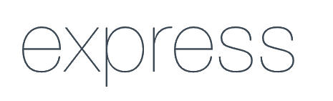
Express
Express.js is a minimalist and flexible Node.js web application framework that provides a robust set of features for building web and mobile applications. It is designed to create APIs and handle HTTP requests and responses effectively, simplifying the process of building server-side applications in Node.js.
We have already learnt the basic of Express in part 3 previously.

Slide 5
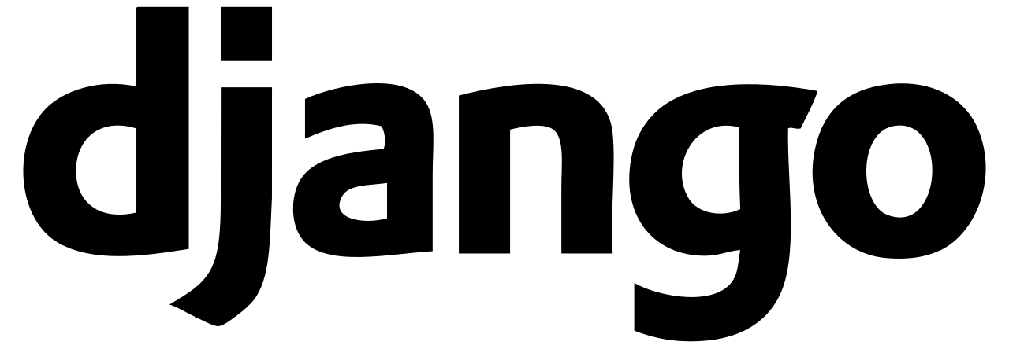
Django
Django is a high-level Python framework known for its "batteries-included" approach, offering a robust set of tools and libraries for building web applications quickly and efficiently. It follows the MVC (Model-View-Controller) architectural pattern and emphasizes reusability and rapid development.

Slide 6

Flask
Flask is a lightweight and versatile Python web framework that is popular for its simplicity and ease of use. It is suitable for developing small to medium-sized web applications quickly and efficiently. Flask is known for its extensibility and is often used for prototyping and building web APIs.

Slide 7
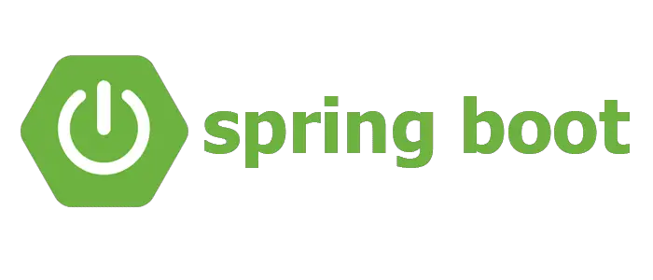
Spring Boot
Spring Boot is a Java-based framework that simplifies the development of production-ready applications by providing a set of tools and conventions. It is built on top of the Spring framework and offers features like auto-configuration, embedded servers, and production-ready metrics. Spring Boot is widely used for building enterprise-level Java applications.

Slide 8

Laravel
Laravel is a PHP web framework that prioritizes developer productivity and elegant syntax. It offers features like a powerful ORM (Object-Relational Mapping) system, routing, authentication, and templating engine. Laravel follows the MVC pattern and provides tools for tasks like caching, queuing, and more.

